Slide 1
National Diabetes Strategy An Integrated Approach to Quality Improvement Dr. Mahmoud Al Zirie, HMC – National Diabetes Guidelines and care pathways

Slide 2
Conflict of Interest Declaration I do not have an affiliation (financial or otherwise) with a pharmaceutical, medical device, or communications and event planning company.

Slide 3
Challenges In Diabetes Service-Qatar
Variation in Access
Variation in service provision
Variation in Perception
Variation in Implementation
Coordination of Referral Criteria

Slide 4
The National Diabetes Strategy
Awareness and Prevention
Deliver clear messages in targeted promotional campaigns,
reinforced across multiple channels
Lead:
- Dr. Mahmoud Zirie, HMC – Chief, Adult Diabetes
Members:
- Ms. Enas A/Gadir Abdoun Osman, HMC - Clinical Pharmacist, National Diabetes Center, HGH
- Dr. Mohamed Bashir, Clinical Lead, Pregnancy and Diabetes
- Dr. Dahila Mustafa Hassan, Consultant, PHCC
- Dr. Mohsin Saleh Ahmed Mismar, Head of Service Improvement, PHCC
- Ms. Joelle Bevington, Program Manager, PHCC
- Dr. Ameena Fakhroo, Consultant PHCC & Physician in Charge of Al Thumama Health Center
Patient Empowerment
Provide education and coaching to empower patients
to take action to improve their own health outcomes
Care Delivery
Design the governance, structure, process to guide HCPs
and patients around the new diabetes care model
Human Capital and Capacity Building
Build the pool of diabetes care resources, increase capability,
developing the infrastructure, policies and enablers
Objectives
Establish Guidelines & Protocol Work Group
Develop enforceable guidelines for public and private sector
Obtain national agreement on standardized clinical guidelines, referral criteria and protocols, i.e. patient pathways
Design national coordination of care process
Information Management
Build new policies, infrastructure and capabilities for health
information collection, analysis, communication and reporting
Research
Govern the national research agenda and to build the national
diabetes research platform, infrastructure and capabilities

Slide 5
Main objectives of the National Diabetes Clinical Guidelines - Qatar
Reduce unwarranted variation in care delivery and improve value from Diabetes healthcare system as a whole.
Adapt international best practice to the Qatar National context.
Enable Insurers and Providers to understand best practice interventions in the diagnosis and management of diabetes in Qatar.

Slide 6
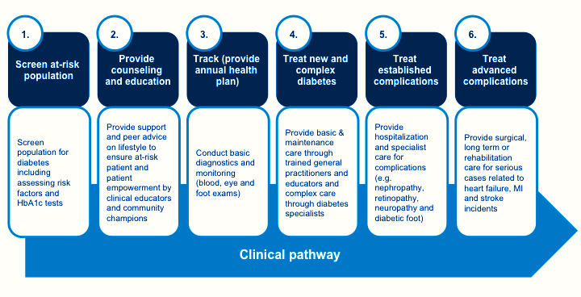
Diabetes Guidelines Goals
The goal will be to form integrated, multi-disciplinary diabetes teams :
Diabetologists, primary care practitioners, nurses, educators, community champions, ophthalmologists, podiatrists, and other specialists) that can provide holistic and patient-centric care
screening, counseling, tracking, initial diagnosis
simple diabetes care, complex diabetes care, established complication care, and advanced diabetes care
care coordination
scheduling process for appointments and annual plans
referral process and follow-up process

Slide 7
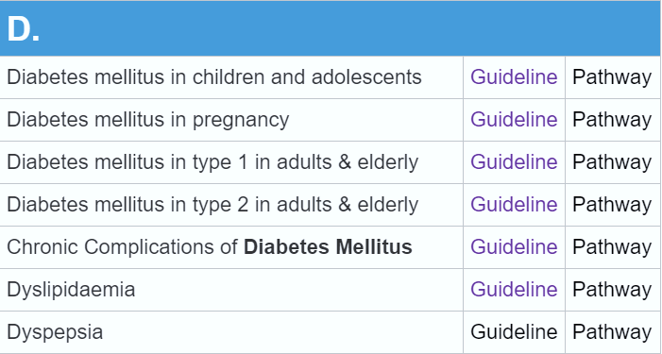
Developed Diabetes Guidelines-Qatar
Type 1 DM in adults & elderly
Type 2 DM in adults & elderly
Diabetes in children & adolescents
Diabetes in pregnancy
Chronic complications of diabetes
Diabetes In Special Situations
Diabetes Screening
Prediabetes
High Risk Group

Slide 8
Guidelines Elements-Type 2 DM
Classifications
Diagnostic Criteria
Risk Factors
Epidemiology
Clinical Evaluation
- Medical history, Examination, Lab. evaluation
Management of Type 2 DM: Non-pharmacological
- Multidisciplinary Team - Education
- Diet Therapy - Exercise
- Smoking Cessation - Weight Management
- Psychological Care - Immunization
- Glucose Monitoring - Glucose Targets

Slide 9
Guidelines Elements-Type 2 DM
Management of Type 2 DM: Pharmacological
- Monotherapy - Dual Therapy
- Triple Therapy - Injectable Therapy
Hypoglycemia
ASCVD
- Hypertension
- Lipids
- Antiplatelets
Diabetes and Fasting Ramadan
Diabetes in Elderly
Referral from Primary to Specialist care

Slide 11
Top 10 National Guidelines viewed since Jan 2017

Slide 12
Coordinated Diabetes Care-Qatar

Slide 13
Thank You

