Slide 1


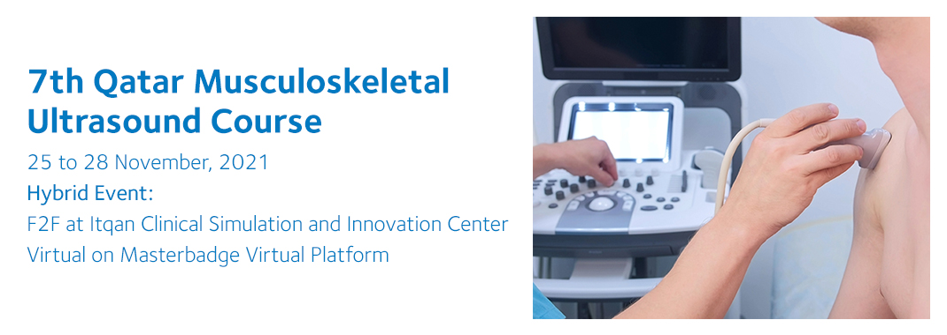
Name:

Slide 2
Application requirement
You are required to submit at least total 30 images- normal or some pathology, for the following joint regions:
[each joint 5-8 different scans]
  Shoulder
  Elbow
  Wrist & Hand
  Hip
  Knee
  Ankle & Foot
  Size not more than 25MB

Slide 3
Application requirement
Please use the following powerpoint slides to insert the legend to the examination of the different joint regions.
If you require more slide pages, please just «Copy and Paste» the slides to insert similar slides.
Thank you!

Slide 4
Application requirement
The scans per joint regions should include all relevant structures for rheumatologists learnt in the Basic course
The EULAR Ultrasound Scanning Guide can be used as a reference. [http://ultrasound.eular.org/#/home]
Each slide must include both a longitudinal and transverse ultrasound scan demonstrating a particular anatomical structure
Each ultrasound image should include the initials of the bony landmarks and the most relevant structures that appear in the scan
A legend to the scan must be provided, including the anatomical area and scanning plane
Images must not contain patient data.

Slide 5
Application requirement
Check before you send:
  Is the essential information presented?
  Do slides ONLY show relevant data (remove all other)
  Make sure NO patient data is shown
  Have you included both a longitudinal and a transverse scan? – important for evaluation
  Plain, white background slides are preferred
.

Slide 6
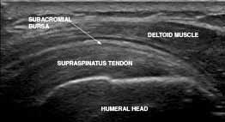
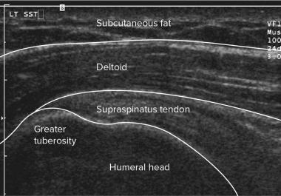

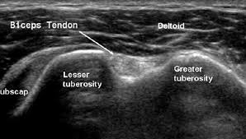
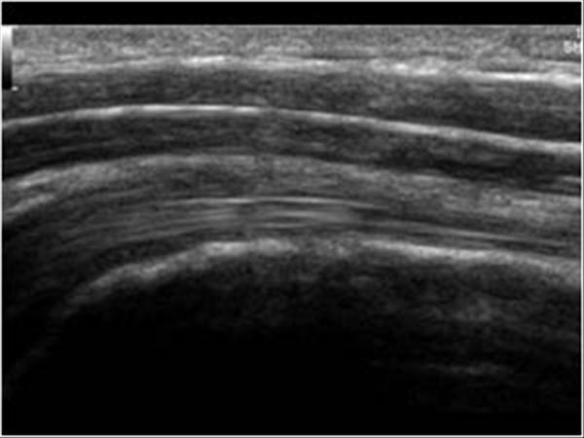
7th QMUSC intermediate course
  Longitude Biceps
Description
Faculty Feed Back

Slide 7
7th QMUSC intermediate course
  Shoulder, example-
  Biceps- Transverse and Longitudinal
  Subscapularis- Transverse and Longitudinal
  Supraspinatus, Infraspinatus, rotator cuff Both plane
  Glenohumeral Joint, AC joints
  You can choose the most important images.
  2 images can be pasted in one page
Description
Faculty Feed Back

Slide 8
Shoulder
Description
Faculty Feed Back

Slide 9
Elbow
Description
Faculty Feed Back

Slide 10
Hand/wrist
Description
Faculty Feed Back

Slide 11
Hip
Description
Faculty Feed Back

Slide 12
Knee
Description
Faculty Feed Back

Slide 13
Ankle/foot
Description
Faculty Feed Back

